Slide 1
Hidden Markov Models

Slide 2
Overview
Markov models
Hidden Markov models(HMM)
Issues Regarding HMM
Algorithmic approach to Issues of HMM

Slide 3
Markov Models
A Markov model is a finite state machine with N distint states begins at (Time t = 1) in initial state .
It moves from current state to Next state according to the transition probabilities associated with the Current state
This kind of system is called Finite or Discrete Markov model.

Slide 4
Markov Property
Markov Property : The Current state of the system depends only on the previous state of the system
The State of the system at Time [ T+1 ] depends on the state of the system at time T.
X_{t=1}
X_{t=2}
X_{t=3}
X_{t=4}
X_{t=5}

Slide 5
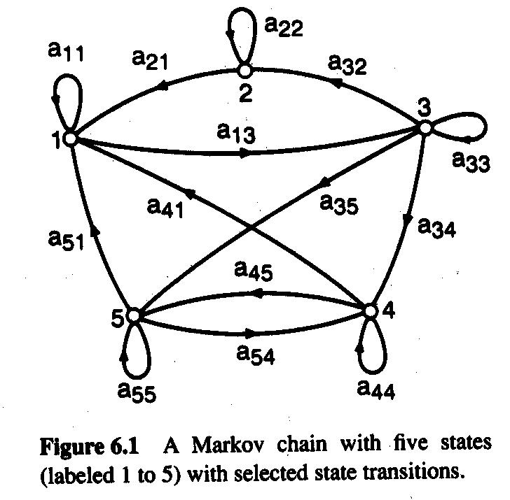
Discrete Markov Model : Example
A Discrete Markov Model with 5 states.
Each aij represents the probability of moving from state ‘ i’ to state ’j’.

Slide 6
Example
The probability to start in a given state I is π_{i}.
The Vector π represents the start probabilities.
To define Markov model, the following probabilities have to be specified: transition probabilities aij = P(Si | Sj ) and
initial probabilities
π_{i} = P( Si )

Slide 7
Hidden Markov Models
A Hidden Markov model is a statistical model in which the system being modelled is assumed to be markov process with unobserved hidden states.
In Regular Markov models the state is clearly visible to others in which the state transition probabilities are the parameters only where as in HMM the state is not visible but the output is visible.

Slide 8
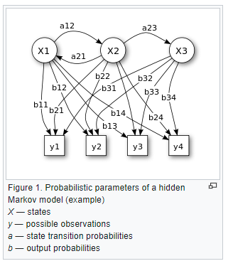

Slide 9
Description
It consists of set of states : S1,S2,S3…….sn.
Process moves from One state to another state generating a sequence of states Si1,Si2,….Sik…
Markov chain property: probability of each subsequent state depends only on what was the previous state
P( Sik | Sk1,Si2,……..Sik-1) = P ( Sik | Sik-1)
States are not visible, but each state randomly generates one of M observations (or visible states)
V = { v1,v2,v3…..vk…..}

Slide 10
Essentials
To define hidden Markov model, the following probabilities have to be specified: matrix of transition probabilities A=(a_{ij}), a_{ij}= P(s_{i} | s_{j}) , matrix of observation probabilities
B=(b_{i} (v_{m} )), b_{i}(v_{m} ) = P(v_{m} | s_{i}) and a vector of initial probabilities π=(π_{i}), π_{i} = P(s_{i}) . Model is represented by M=(A, B, π).

Slide 11
Hidden markov models ( Probabilistic finite state automata )
The Scenarios where states cannot be directly observed.
We need an extension i.e, Hidden Markov Models
a₁₁
a₂₂
a₃₃
a₄₄
a₁₂
a₂₃
a₃₄
b₁₁
b₁₄
b₁₃
b₁₂
4
1
2
3

Slide 12
a_{ij} are state transition probabilities.
b_{ik} are observation (output) probabilities.
b₁₁ + b₁₂ + b₁₃ + b₁₄ = 1,
b₂₁ + b₂₂ + b₂₃ + b₂₄ = 1.

Slide 13
Hidden Markov Models - HMM
Hidden variables
H₁
H₂
H_{i}
H_{L-1}
H_{L}
X₁
X₂
X_{i}
X_{L-1}
X_{L}
Observed data

Slide 14
Hidden markov model recognition
For a given model M = { A, B, p } and a given state sequence Q₁ Q₂ Q₃ … Q_{L} , the probability of an observation sequence O₁ O₂ O₃ … O_{L} is
P(O|Q,M) = bQ₁O₁ bQ₂O₂ bQ₃O₃ … bQ_{T}O_{T}
For a given hidden Markov model M = { A, B, p}
the probability of state sequence Q₁ Q₂ Q₃ Q_{L}
is (the initial probability of Q₁ is taken to be pQ₁)
P(Q|M) = pQ₁ aQ₁Q₂ aQ₂Q₃ aQ₃Q₄ … aQ_{L-1}Q_{L}

Slide 15
Hidden markov model recognition
So for a given HMM, M the probability of an observed sequence O₁O₂O₃ … O_{T} is obtained by summing over all possible state sequences.
P(Q|M) = πQ₁ aQ₁Q₂ aQ₂Q₃ aQ₃Q₄ … aQ_{T-1}Q_{T}
P(O|Q) = bQ₁O₁ bQ₂O₂ bQ₃O₃ … bQ_{T}O_{T}

Slide 16
Main issues ?
Evaluation problem: Given the HMM
M = { A, B, π } and observation sequence
O = o1,o2 ……ok, Caluculate the probability that model m has generated sequence O.
Decoding problem : : Given the HMM
M = { A, B, π } and observation sequence
O = o1,o2 ……ok, Caluculate the most likely sequence of hidden states Si that generated sequence O.

Slide 17
Weather guessing game
Learning Problem : Given some training observation sequences O = o1,o2 ……ok, and general structure of HMM( visible and hidden states) Determine HMM parameters that best fit the training data.

Slide 18
Solutions to evacuation problem ?
Evaluation problem: For this problem We use an Forward- Backward algorithm
This algorithm mainly consists of defining a forward or backward variable as the joint probability of partial state sequence such as
O = o1, o2, …..ok and the hidden state Si at time k is αk(i) = p(o1 o2 o3…ok, Qk = Si).
The three states in this algorithm are initilaisation, forward recursion and termination.

Slide 19
Solutions to linear problem
The solution to this problem is to estimate parameters.
The parameters that need to be estimated are Tranmission probabilities and emission probabilities. Since they sum upto 1, only 2 tranmission and 2 estimation parameters are to be found.
More parameter estimation be done using
Baun-Welch algorithm

Slide 20
Weather guessing game
Consider two friends, Alice and Bob, who live far apart from each other and who talk together daily over the telephone about what they did that day. Bob is only interested in three activities: walking in the park, shopping, and cleaning his apartment. The choice of what to do is determined exclusively by the weather on a given day.
Alice believes that the weather operates as a discrete Markov chain. There are two states, "Rainy" and "Sunny", but she cannot observe them directly, that is, they are hidden from her. On each day, there is a certain chance that Bob will perform one of the following activities, depending on the weather: "walk", "shop", or "clean". Since Bob tells Alice about his activities, those are the observations. The entire system is that of a hidden Markov model (HMM).
Alice knows the general weather trends in the area, and what Bob likes to do on average. In other words, the parameters of the HMM are known.

Slide 21
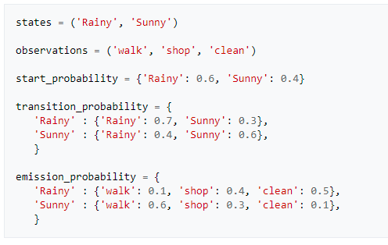
Construct State Transition Diagram

Slide 22
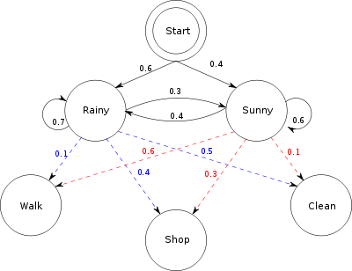

Slide 23
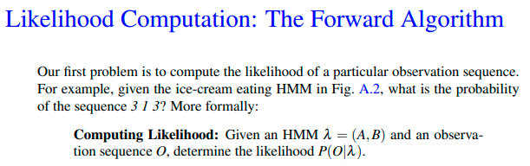
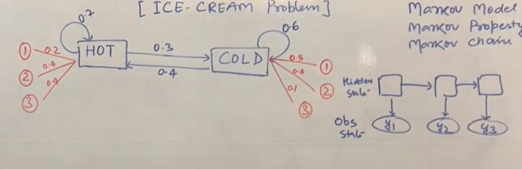
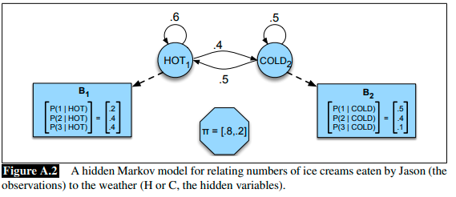

Slide 24
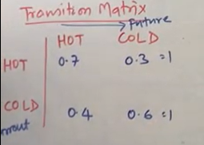
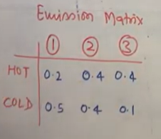

Slide 25
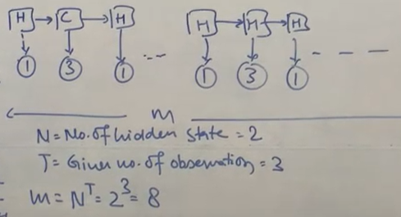
viterbi algorithm

Slide 26
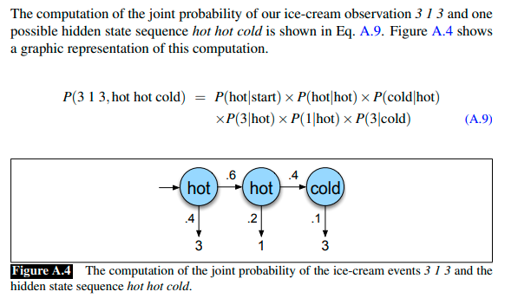


Slide 27
Solution to decoding problem ?
Decoding problem: Viterbi Algorithm
In this algorithm we go through the observations from start to end referring a state of hidden machine for each observation.
We also record the values of Overall Probability,
Viterbi path (sequence of states) and the viterbi probability( Probability of observed state sequences in viterbi path )
The probability of possible step given its corresponding observation is probability of transmission times the emission probability.

Slide 28
Viterbi algorithm
Overall Probability : Multiply each new probability with the old one and then add together.
Viterbi probability : Take the highest next step probability and multiply with the next step viterbi probability.
Viterbi path : Add the next step path to viterbi path.

Slide 29
viterbi algorithm with example
A person basically does 3 activities walk, clean and shop depending on the weather conditions?
Possibility of weather conditions are ‘Rainy’ and ‘sunny’.
In this example weather condition states are hidden and we will know the weather condition by her activities.

Slide 30
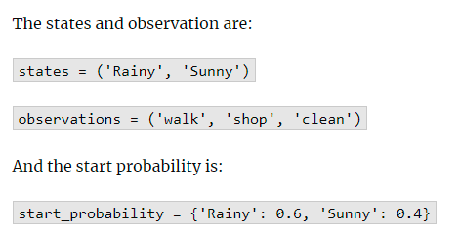

Slide 31
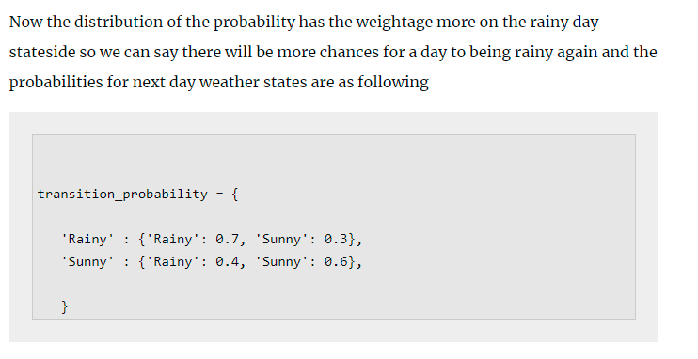

Slide 32
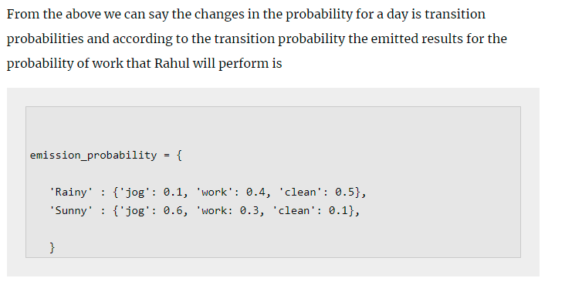

Slide 33
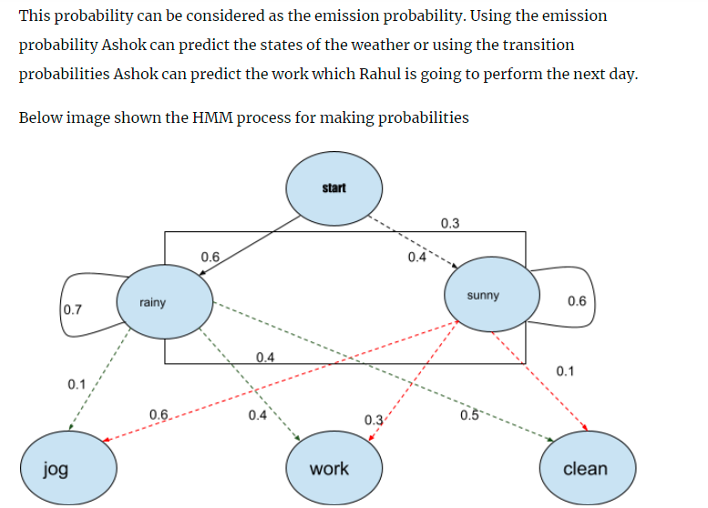

Slide 34
Viterbi algorithm with example
As we discussed in earlier slides for every hidden markov model ( HMM ) we need an Transition probabilities and Emission probabilities.
The transition probabilities are :
P( R ---> R) (Rainy stays rainy) = 0.7
P( R ---> S) ( Rainy turns into Sunny ) = 0.3
P ( S ---> S) ( Sunny stays into sunny ) = 0.6
P ( S----> R) (Sunny turns into rainy ) = 0.4

Slide 35
Viterbi algorithm with example
The Observations of her activities is
If it is Rainy the behaviour is
Walk = 0.1
Clean = 0.5
Shop = 0.4
If it is Sunny the behaviour is
Walk = 0.6
Clean = 0.3
Shop = 0.1

Slide 36
Viterbi algorithm with example
If the observations are WCSW
Then according to algorithm find the overall prob, vit Prob, vit_path.
In vi_path you get the sequence of states which need to compare with the original states in order to know the accuracy
Through many examples the accuracy varies between 80-90%

Slide 37
Consider the Ice-Cream Problem
Use VITERBI Algorithm for the following.
Consider the observations of John eating ice-cream for three consecutive days is {3,1,3}.
IDENTIFY THE HIDDEN STATE USING VITERBI ALGORITHM

Slide 38
H
H
H
C
C
C
3
1
3

Slide 39
Applications of HMM
Cryptanalysis
Speech Recognition
Pattern Recognition
Activity Recognition
Machine Translation

Slide 40
References
http://en.wikipedia.org/wiki/Hidden_Markov_model
www.evl.uic.edu/shalini/coursework/hmm
www.cedar.buffalo.edu/~govind/CS661/Lec12.ppt
www.bios.niu.edu/johns/bioinf.../Hidden%20Markov%20Models.ppt
www.ece.drexel.edu/gailr/ECE-S690-503/markov_models.ppt.pdf

Slide 41
Thank you

